Slide 1



Futurion
Date of Submission : 18/02/2025
UPSKILLING INDIA
Data Analysis
Portfoliio Project Challenge
Lung Cancer Prediction
Anidipta Pal
<SQL> <Excel> <PowerBI>
01

Slide 2
Futurion
Business Problem/Goal of the Analysis
The goal of the analysis is to utilize the Lung Cancer Prediction Dataset to predict the likelihood of lung cancer in individuals based on demographic, medical, lifestyle, genetic, and
environmental factors. The analysis aims to assist in identifying high-risk individuals,
providing early detection insights, and informing personalized treatment strategies
for lung cancer. The primary objective is to develop a predictive model that
can accurately identify potential lung cancer patients, assess survival
rates, and support healthcare providers in making data-driven
decisions for patient care and treatment
planning.
UPSKILLING INDIA
Objectives of the Project:
Normalize or standardize relevant fields (e.g., age, blood counts).
1
Predict Lung Cancer Diagnosis: Build a model to predict lung cancer diagnosis.
Survival Analysis: Assess risk factors affecting lung cancer survival rates.
Mortality Risk Prediction: Predict mortality rates for lung cancer patients.
2
Feature Importance Identification: Identify key factors influencing lung cancer diagnosis and prognosis.
Early Detection Strategy: Develop strategies for early detection of lung cancer.
Treatment Recommendations: Recommend treatments based on patient risk factors and cancer stage.
3
4
02
5
6

Slide 3
Futurion
UPSKILLING INDIA
except STRING TYPES
Data Description
Statistical Analysis < Excel >
Column | mean | sd | p0 | p25 | p50 | p75 | p100
ID | 110300 | 63690 | 0 | 55160 | 110300 | 165500 | 220600
Population_Size | 229.8 | 349.2 | 54 | 83 | 113 | 206 | 1400
Age | 52.52 | 19.08 | 20 | 36 | 53 | 69 | 85
Years_of_Smoking | 8.175 | 12.38 | 0 | 0 | 0 | 15 | 40
Cigarettes_per_Day | 7.008 | 9.802 | 0 | 0 | 0 | 14 | 30
Survival_Years | 0.2235 | 1.231 | 0 | 0 | 0 | 0 | 10
Annual_Lung_Cancer_Deaths | 63930 | 130700 | 10000 | 23000 | 30000 | 45000 | 690000
Lung_Cancer_Prevalence_Rate | 1.502 | 0.578 | 0.5 | 1 | 1.5 | 2 | 2.5
Mortality_Rate | 3.05 | 14.92 | 0 | 0 | 0 | 0 | 90
Source → Lung Cancer Dataset Github Link
There are 220632 Rows and 24 Columns.
Columns : 'ID', 'Country', 'Population_Size', 'Age', 'Gender', 'Smoker',
’Years_of_Smoking', 'Cigarettes_per_Day','Passive_Smoker',
'Family_History', 'Lung_Cancer_Diagnosis',‘Cancer_Stage',
'Survival_Years','Adenocarcinoma_Type','Air_Pollution_Exposure',
’Occupational_Exposure', 'Indoor_Pollution', 'Healthcare_Access',
'Early_Detection','Treatment_Type', 'Developed_or_Developing',
'Annual_Lung_Cancer_Deaths', 'Lung_Cancer_Prevalence_Rate',
'Mortality_Rate'
Data Types : String → 15, Integer → 7 , Float → 2
Data Cleaning / Preprocessing
2 Columns has Missing Values → Cancer_Stage : 211671, Treatment_Type : 213968
Preprocessing → Fill Missing values in Cancer_Stage with ‘Stage 0’ and for Treatment_Type with ‘NaN’
Duplicated Values → None
03

Slide 4
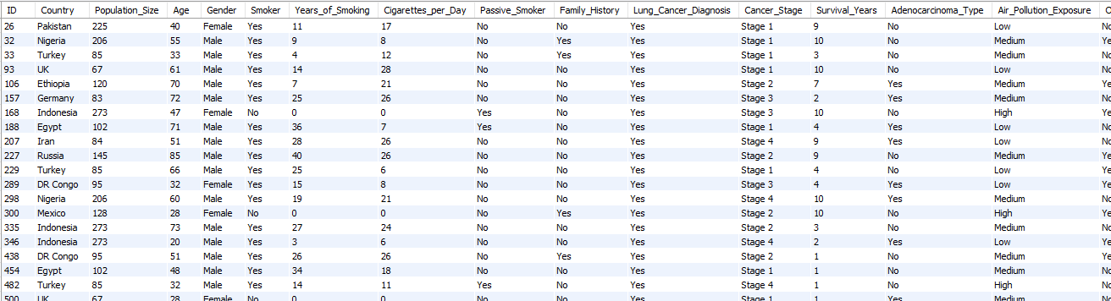


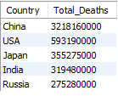



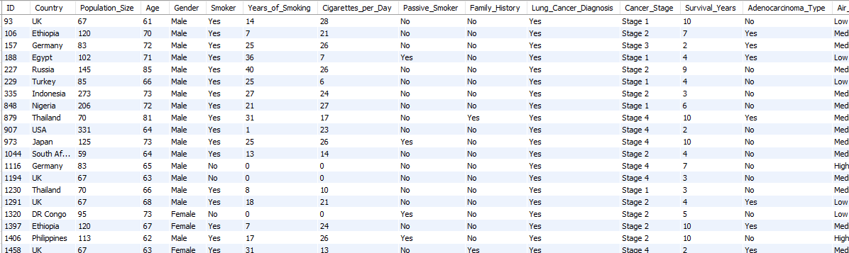
Futurion
< SQL >
Basic Level
UPSKILLING INDIA
-- 1. Retrieve all records for individuals diagnosed with lung cancer.
→ SELECT * FROM lung_cancer_data WHERE Lung_Cancer_Diagnosis = 'Yes';
-- 2. Count the number of smokers and non-smokers.
→ SELECT Smoker, COUNT(*) FROM lung_cancer_data GROUP BY Smoker;
-- 3. List all unique cancer stages present in the dataset.
→ SELECT DISTINCT Cancer_Stage FROM lung_cancer_data;
-- 4. Retrieve the average number of cigarettes smoked per day by smokers.
→ SELECT AVG(Cigarettes_per_Day) FROM lung_cancer_data WHERE Smoker = 'Yes';
-- 5. Count the number of people exposed to high air pollution.
→ SELECT COUNT(*) FROM lung_cancer_data WHERE Air_Pollution_Exposure = 'High';
-- 6. Find the top 5 countries with the highest lung cancer deaths.
→ SELECT Country, SUM(Annual_Lung_Cancer_Deaths) AS Total_Deaths
FROM lung_cancer_data GROUP BY Country ORDER BY Total_Deaths DESC LIMIT 5;
-- 7. Count the number of people diagnosed with lung cancer by gender.
→ SELECT Gender, COUNT(*) FROM lung_cancer_data WHERE Lung_Cancer_Diagnosis = 'Yes' GROUP BY Gender;
-- 8. Retrieve records of individuals older than 60 who are diagnosed with lung cancer.
→ SELECT * FROM lung_cancer_data WHERE Age > 60 AND Lung_Cancer_Diagnosis = 'Yes';
1
2
4
6
3
5
7
8
04

Slide 5

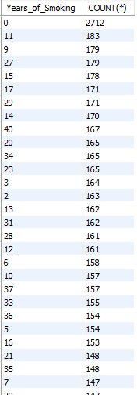
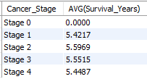




Futurion
< SQL >
Intermediate Level
UPSKILLING INDIA
-- 1. Find the percentage of smokers who developed lung cancer.
→ SELECT (COUNT(*) * 100.0 / (SELECT COUNT(*) FROM lung_cancer_data)) AS Percentage_Smokers_With_Lung_Cancer FROM lung_cancer_data WHERE Smoker = 'Yes' AND Lung_Cancer_Diagnosis = 'Yes';
-- 2. Calculate the average survival years based on cancer stages.
→ SELECT Cancer_Stage, AVG(Survival_Years) FROM lung_cancer_data GROUP BY Cancer_Stage;
-- 3. Count the number of lung cancer patients based on passive smoking.
→ SELECT Passive_Smoker, COUNT(*) FROM lung_cancer_data WHERE Lung_Cancer_Diagnosis = 'Yes' GROUP BY Passive_Smoker;
-- 4. Find the country with the highest lung cancer prevalence rate.
→ SELECT Country, Lung_Cancer_Prevalence_Rate FROM lung_cancer_data ORDER BY Lung_Cancer_Prevalence_Rate DESC LIMIT 1;
-- 5. Identify the smoking years' impact on lung cancer.
→ SELECT Years_of_Smoking, COUNT(*) FROM lung_cancer_data WHERE Lung_Cancer_Diagnosis = 'Yes' GROUP BY Years_of_Smoking ORDER BY COUNT(*) DESC;
-- 6. Determine the mortality rate for patients with and without early detection.
→ SELECT Early_Detection, AVG(Mortality_Rate) FROM lung_cancer_data GROUP BY Early_Detection;
-- 7. Group the lung cancer prevalence rate by developed vs. developing countries.
→ SELECT Developed_or_Developing, AVG(Lung_Cancer_Prevalence_Rate) FROM lung_cancer_data GROUP BY Developed_or_Developing;
1
5
2
3
4
6
7
05

Slide 6

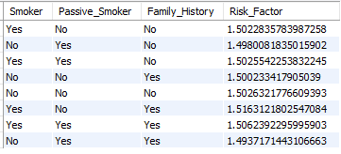
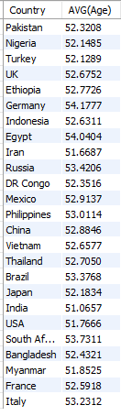
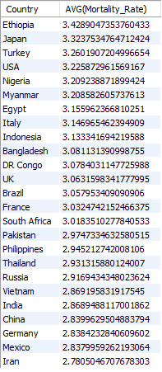
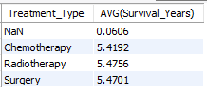


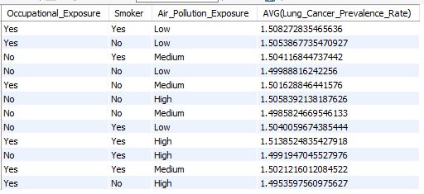
Futurion
< SQL >
Advanced Level
UPSKILLING INDIA
-- 1. Identify the correlation between lung cancer prevalence and air pollution levels.
→ SELECT Air_Pollution_Exposure, AVG(Lung_Cancer_Prevalence_Rate) FROM lung_cancer_data GROUP BY Air_Pollution_Exposure;
-- 2. Find the average age of lung cancer patients for each country.
→ SELECT Country, AVG(Age) FROM lung_cancer_data WHERE Lung_Cancer_Diagnosis = 'Yes' GROUP BY Country;
-- 3. Calculate the risk factor of lung cancer by smoker status, passive smoking, and family history.
→ SELECT Smoker, Passive_Smoker, Family_History, AVG(Lung_Cancer_Prevalence_Rate) AS Risk_Factor FROM lung_cancer_data GROUP BY Smoker, Passive_Smoker, Family_History;
-- 4. Rank countries based on their mortality rate.
→ SELECT Country, AVG(Mortality_Rate) FROM lung_cancer_data GROUP BY Country ORDER BY AVG(Mortality_Rate) DESC;
-- 5. Determine if treatment type has a significant impact on survival years.
→ SELECT Treatment_Type, AVG(Survival_Years) FROM lung_cancer_data GROUP BY Treatment_Type;
-- 6. Compare lung cancer prevalence in men vs. women across countries.
→ SELECT Gender, AVG(Lung_Cancer_Prevalence_Rate) FROM lung_cancer_data GROUP BY Gender;
-- 7. Find how occupational exposure, smoking, and air pollution collectively impact lung cancer rates.
→ SELECT Occupational_Exposure, Smoker, Air_Pollution_Exposure, AVG(Lung_Cancer_Prevalence_Rate) FROM lung_cancer_data GROUP BY Occupational_Exposure, Smoker, Air_Pollution_Exposure;
-- 8. Analyze the impact of early detection on survival years.
→ SELECT Early_Detection, AVG(Survival_Years) FROM lung_cancer_data GROUP BY Early_Detection;
1
3
2
4
5
6
8
7
06

Slide 7
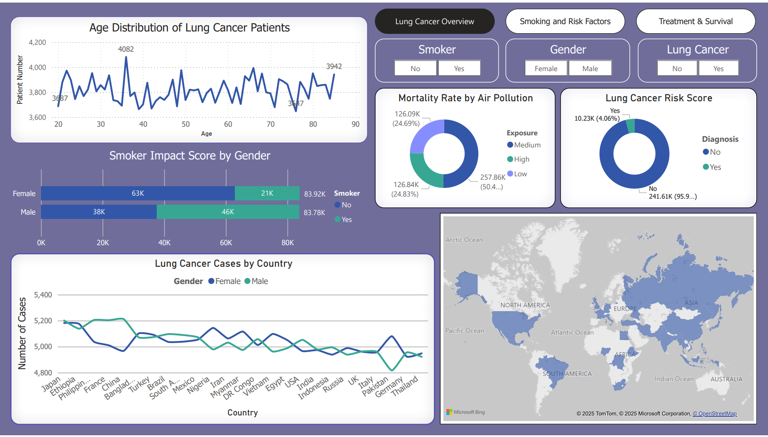
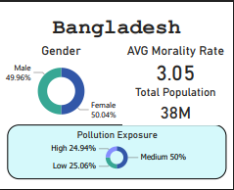
Futurion
< Data Visualization & Dashboard >
UPSKILLING INDIA
Key Stats: 8,961 cases, avg. age 52.66, 69.73% smokers, 75.09% mortality.
Observations: More cases in Asia, males higher, peak at 30-40 (~35).
Risks: Smoking impact severe, pollution raises mortality, high-risk patients need prevention.
07

Slide 8
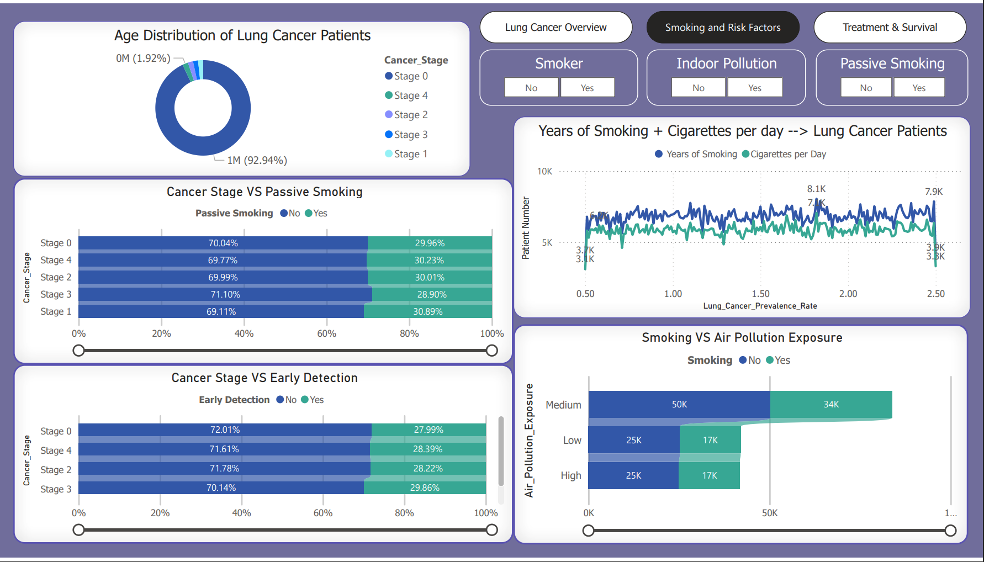
Futurion
< Data Visualization & Dashboard >
UPSKILLING INDIA
Key Stats: 88,341 smokers, avg. smoking years 20.41, 4.5% high-risk, 28.37% early detection.
Observations: More smokers = more cancer, 15+ years smoking → later-stage diagnosis, passive smoking → 30% higher risk.
Risks: High smoking impact → more cancer, pollution + smoking worsen risk, early detection → less advanced cases.
08

Slide 9
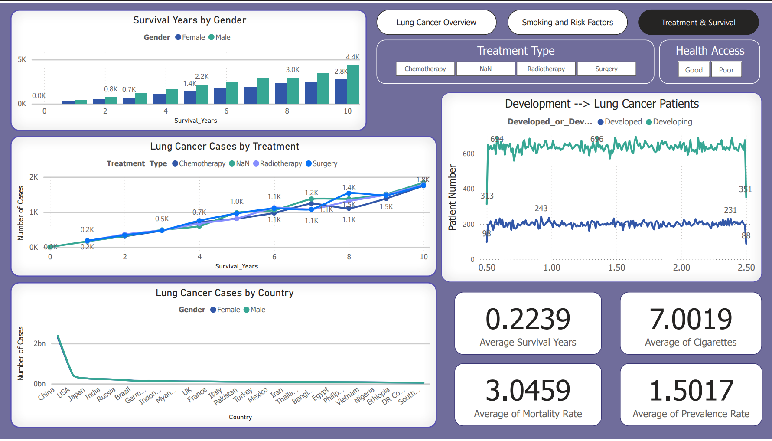
Futurion
< Data Visualization & Dashboard >
UPSKILLING INDIA
Key Stats: Avg. survival 5.5 years, 14.1B deaths/year, prevalence 1.50, early detection 100% survival.
Observations: Surgery improves survival, deaths vary by country, developed nations report higher prevalence.
Risks & Insights: Surgery lowers mortality, early-stage diagnosis boosts survival, gender differences affect survival rates.
09

Slide 10
Futurion
< Conclusion >
UPSKILLING INDIA
Lung cancer remains a critical public health issue, with smoking and environmental factors driving incidence and mortality. Early detection and effective treatment, especially surgical intervention, significantly improve survival rates.
Disease Burden: 8,961 cases, avg. age 52.66, remains a major challenge.
Key Risk Factors: 69.74% cases from smoking, 75.09% mortality in polluted areas.
Early Detection Impact: Only 28.37% detected early, but 100% survival if caught in time.
Treatment Outcomes: Surgery (4.5 years) outperforms chemo (2.8 years) & radiation (3.0 years).
< Business Recommendations >
Lung cancer poses a significant health burden, with smoking and environmental exposure as major risk factors. To improve patient outcomes and reduce mortality rates, businesses in healthcare, pharmaceuticals, and public health should focus on the following strategic initiatives:
Prioritize Early Detection Initiatives Invest in advanced diagnostic technologies, such as AI-driven tools and low-dose CT scans, to enhance early lung cancer detection, particularly in high-risk populations.
Expand Smoking Cessation Programs Launch awareness campaigns and provide support for smoking cessation through nicotine replacement therapies and digital interventions to reduce smoking-related lung cancer cases.
Leverage Data for Personalized Treatment Invest in AI and predictive analytics to develop personalized treatment plans and support precision medicine approaches for better outcomes in chemotherapy and immunotherapy.
Promote Environmental Health & Access to Treatment Collaborate with policymakers to reduce air pollution and enhance access to surgical treatments, ensuring affordable care in underserved regions.
10

